Slide 1


Capstone Project Sk.Mastan Vali S9708 Amazon Sales Insights: Analyzing Sales Data Across Branches
Tools used for analysis:

Slide 2
Objective:
The primary goal of this project is to analyze Amazon's sales data from three distinct branches located in Mandalay, Yangon, and Naypyitaw. The analysis aims to uncover meaningful insights into sales trends, customer behavior, product performance, and other factors that influence revenue. This information will help Amazon identify areas of improvement, optimize strategies, and enhance decision-making processes.

Slide 3
Product Trends:
Which product lines generate the most revenue?
Which lines need improvement based on average performance?
Sales Trends:
Which month, day, or time of day sees the highest sales?
Which branch sells the most products?
Customer Insights:
Which customer type contributes the highest revenue?
What are the purchasing patterns for each gender?
Profitability:
In which city is the highest revenue recorded?
Which branch or product line incurs the highest VAT?
Ratings Analysis:
Which time of day or weekday receives the highest customer ratings?

Slide 4


QUESTION FOR THE BUSSINESS DATA
//There are 3 distinct cities in given data

Slide 5
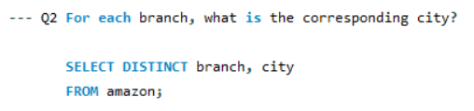
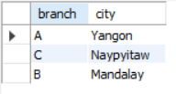
// there are 3 corresponding cities’

Slide 6
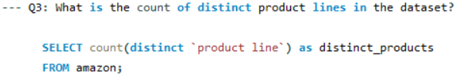

// There are 6 distinct product_lies

Slide 7
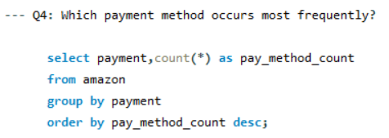
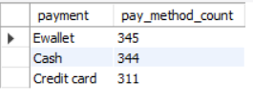
//There are 3 mostly frequented payments

Slide 8
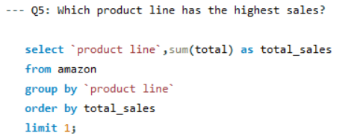

//The highest sales in product line is Health and beauty

Slide 9
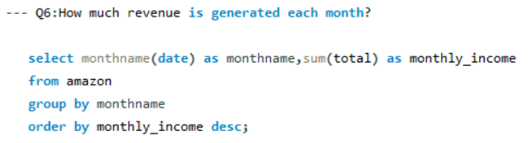
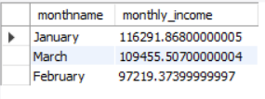

Slide 10
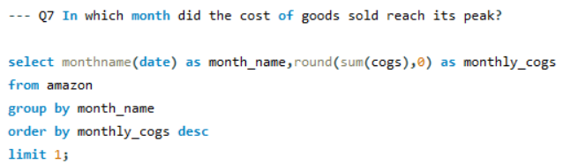

// January is the highest pick in sales

Slide 11
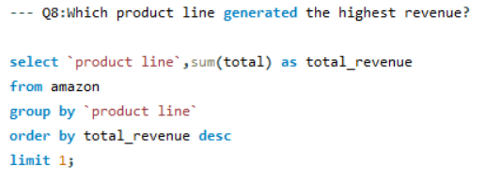

// food and beverages are the generate highest revenue

Slide 12
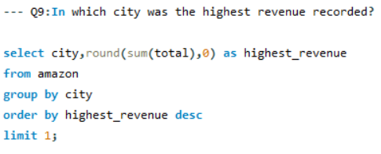

// the highest revenue generated city is Naypyitaw

Slide 13
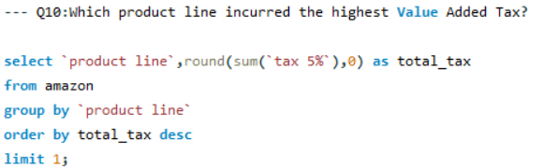

//Food and beverages are the highest tax payer in product line

Slide 14
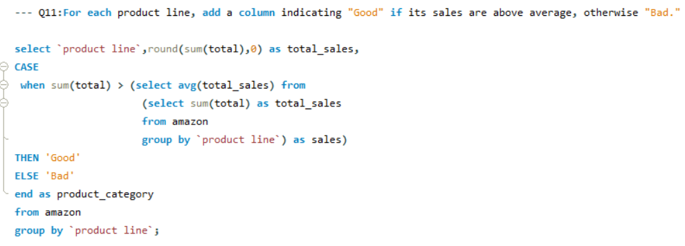
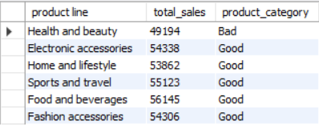

Slide 15
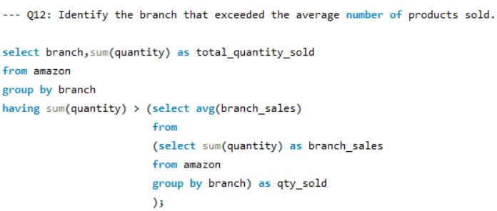


Slide 16
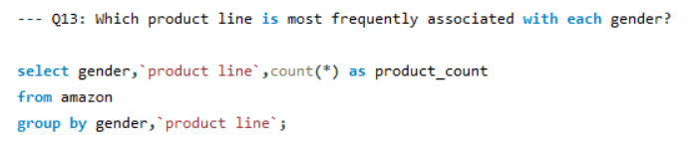
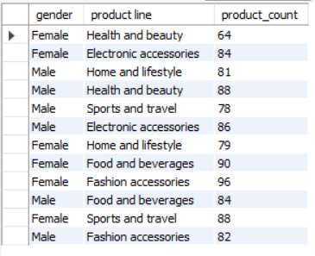

Slide 17
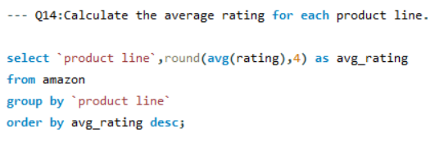
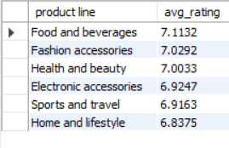

Slide 18
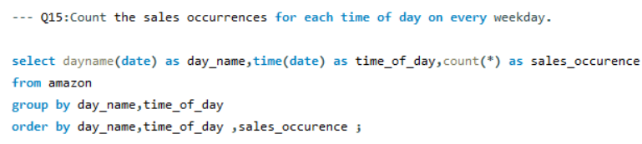
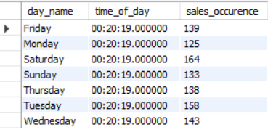

Slide 19
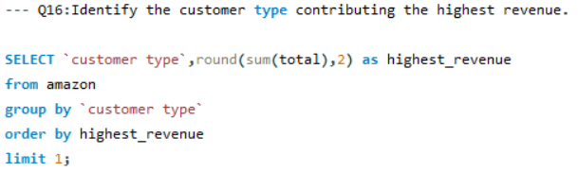


Slide 20
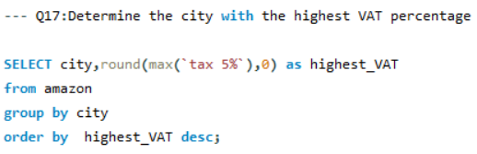

//Naypyitaw is the highest VAT percentage city.

Slide 21
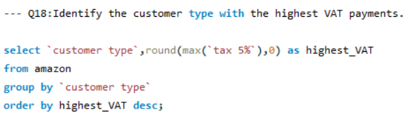

//Member – customer type is highest VAT payments.

Slide 22


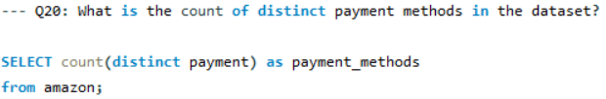


Slide 23
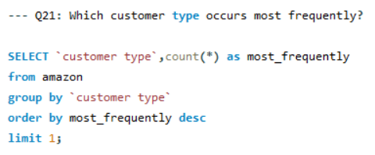

// Member– customer type is most frequently in sales.

Slide 24
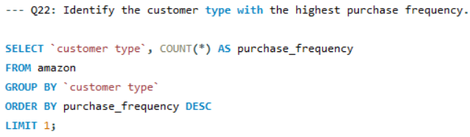

// The member customer type consistently demonstrates the highest purchase frequency based on the data.

Slide 25
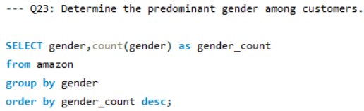


Slide 26
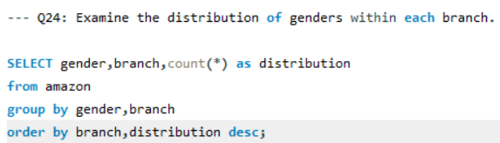
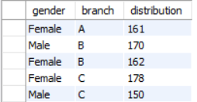

Slide 27
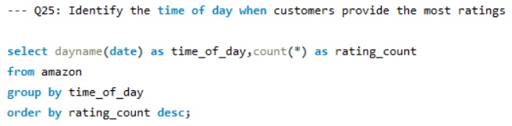
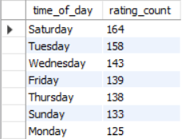

Slide 28
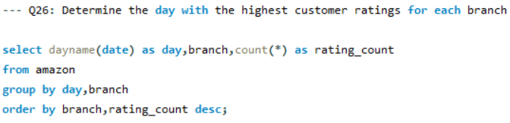
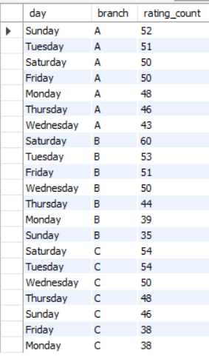

Slide 29
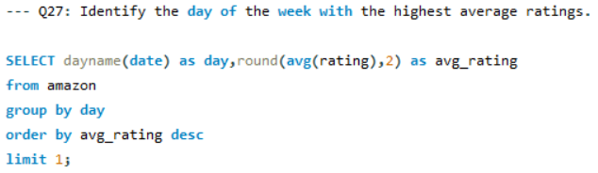


Slide 30
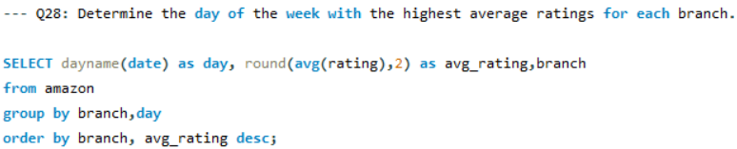
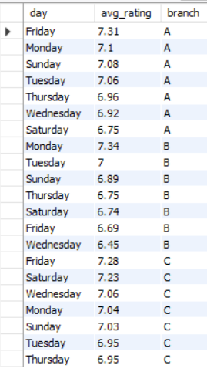

Slide 31
Conclusion: This project aims to transform raw sales data into actionable insights that support Amazon's decision-making. By analyzing sales performance, customer preferences, and product trends, the project seeks to provide a comprehensive understanding of factors driving Amazon’s branch-level sales and revenue.

